Slide 1




LOGO
UNIV/POLTEK
DIGITAL TALENT SCHOLARSHIP
2019
digitalent.kominfo.go.id

Slide 2
Sesi 29 Algoritma Asosiasi
Big Data Analytics

Slide 3
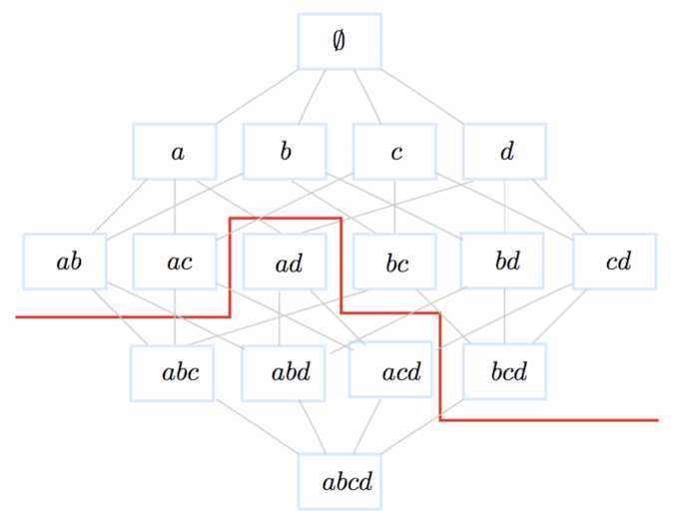
Artificial Intelligence
Machine Learning Association Rules

Slide 4
Outline
1. Introduction
2. A two-step process
3. Applications
4. Definitions and examples
5. Frequent patterns: Apriori algorithm
6. Example
7. Representation of D
8. Definitions cont’d
9. Association rules algorithm
10. Example
11. A probabilistic framework Association Rules
12. Support-confidence cons
13. Quantitative association rules

Slide 5
Introduction
• Unsupervised task.
• R. Agrawal, T. Imielinski and A.N. Swami Mining Association Rules between sets of items in large databases. Proceedings of SIGMOD 1993.
• Highly cited work because of its wide applicability.

Slide 6
Applications
• Market Basket Analysis: cross-selling (ex. Amazon), product placement, affinity promotion, customer behavior analysis
• Collaborative filtering
• Web organization
• Symptoms-diseases associations
• Supervised classification

Slide 7
A two-step process
Given a transaction dataset D
1. Mining frequent patterns in D
2. Generation of strong association rules
Example:
{Bread, Butter} is a frequent pattern (itemset)
Bread ^ Butter is a strong rule

Slide 8
Definitions
• Item: an object belonging to I = {x₁, x₂,x_{m}}.
• Itemset: any subset of I.
• k-itemset: an itemset of cardinality k.
• We define a total order (I, <) on the items.
• P(I) is a lattice with ± = 0 and T = I.
• Transaction: itemset identified by a unique identifier tid.
• T: the set of all transactions ids. Tidset: a subset of T.
• Transaction dataset: D = {(tid, X_{tid}) /tid eT, X_{tid} c I}

Slide 9
Example
D
tid | transaction
1 | a b
2 | a c
3 | c d
4 | bed
5 | abed
item | name
a | coffee
b | milk
c | butter
d | bread
I=
T=
V=

Slide 10
Example
V
item | name
a | coffee
b | milk
c | butter
d | bread
tid | transaction
1 | a b
2 | a c
3 | c d
4 | bcd
5 | abcd
I = {a, b, c, d}
T = {1, 2, 3, 4, 5}
D = {(1, ab), (2, ac), (3
cd), (4, bcd), (5, abcd)}
E.g., {b,c} is a 2-itemset, for writing simplification we will give up the braces and write bc. {3,4,5} is a tidset similarly let's abandon the braces here too and write 345.

Slide 11
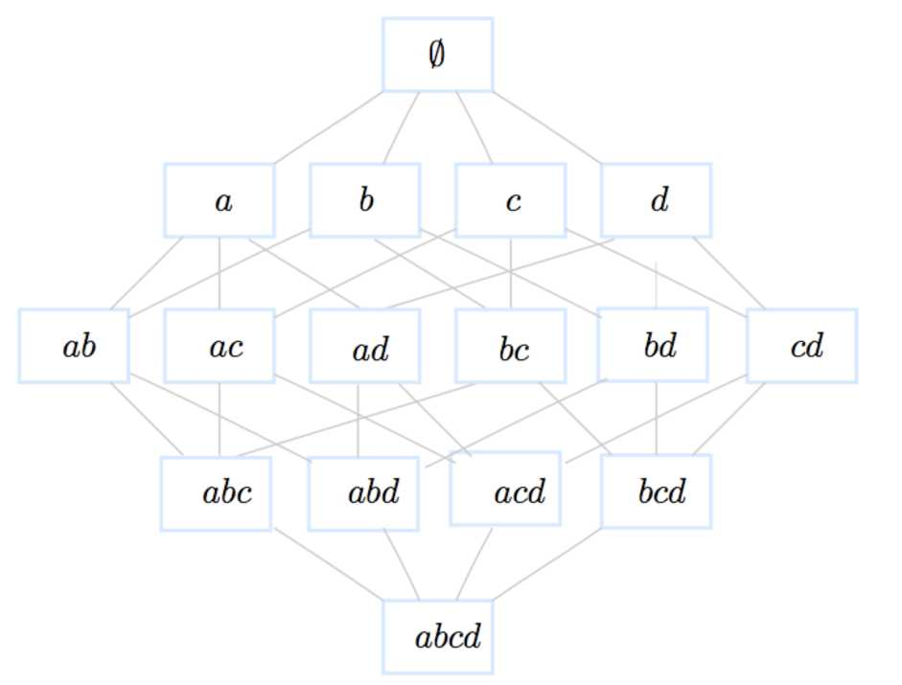
Example
Lattice of itemsets of size ...

Slide 12
Example
Lattice of itemsets of size 2^{|x|} = 16.

Slide 13
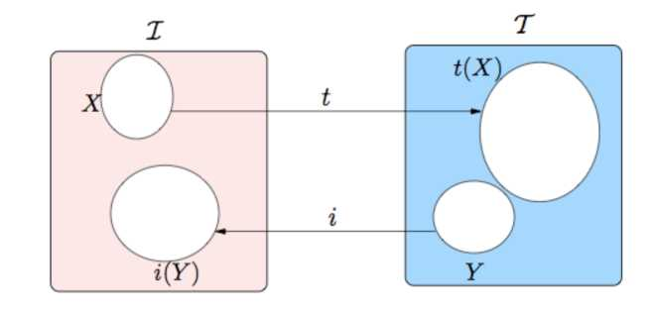
Definitions cont’d
• Mapping t:
t : P (I) — P (T)
^{X — t(X)} = ^{{tid} E ^{T}\3Xtid, ⁽tid, Xtid⁾ EV A X C ^{X}tid}
• Mapping i:
i : P (T) —— P (I)
Y — i(Y) = {x E I\V(tid, X_{tid}) E V, tid E Y ^ x E X_{tid}}

Slide 14
Definitions cont’d
Frequency: freq(X) = |{(tid,X_{tid}) e D/X C X_{tid}}\ = \t(X)| Support: supp(X) = ^{|t}(X\^{)|}
Frequent itemset: X is frequent iff supp(X) > MinSupp
Property (Support downward closure) : if an itemset is frequent then all its subsets also are frequent.
Mining Frequent Itemsets:
F = { X C I| supp(X)> MinSupp}

Slide 15
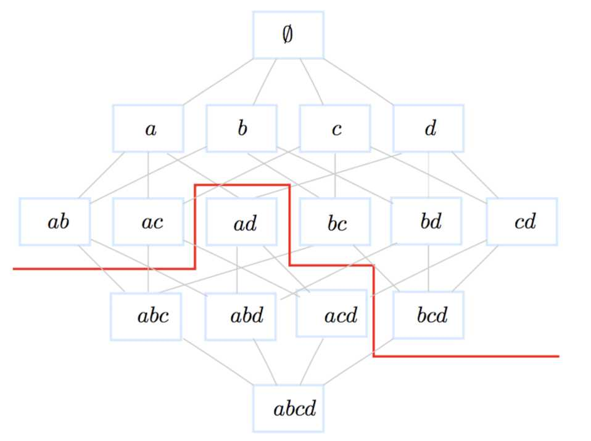
Example
MinSupp=40%

Slide 16
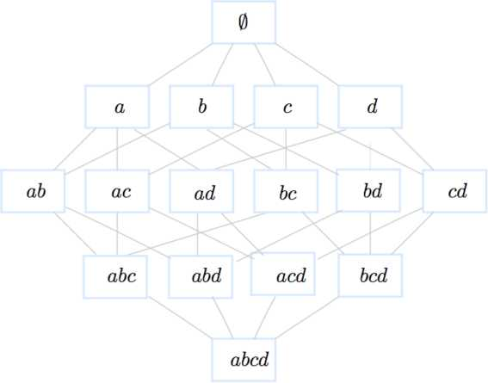
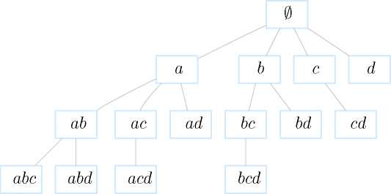
BFS and DFS
abcd
Breadth First Search
Depth First Search

Slide 17
Apriori pseudo-algorithm
Level-wise algorithm - lattice explored with a Breath First Search approach (BFS). Start at level 1 in the lattice: k = 1
• Generate candidates of size k
C_{k} = {(c_{k}, supp(c_{k}))|VX C c_{k}, X = 0, support(X) > MinSupp}
• Scan the dataset to compute the support of each candidate and keep the frequent ones
^{F}k = ^{{(l}k supp(lk))| supp(lk) > Minsupp}
• Go the the next level k = k +1 and redo the process.

Slide 18
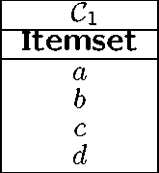
Example
D
tid | transaction
1 | a b
2 | a c
3 | c d
4 | b c d
5 | a b c d
Minsupp=2/5 (40%)
Ci
Itemset | Support
a | 3/5
b | 3/5
c | 4/5
d | 3/5
Fi
Itemset | Support
a | 3/5
b | 3/5
c | 4/5
d | 3/5
C2
Itemset
ab
ac
ad
bc
bd
cd
C2
Itemset | Support
ab | 2/5
ac | 2/5
ad | 1/5
bc | 2/5
bd | 2/5
cd | 3/5
F2
Itemset | Support
ab | 2/5
ac | 2/5
bc | 2/5
bd | 2/5
cd | 3/5
C3 |  | C3
Itemset | Scan | Itemset | Support
abc | -T of D | abc | 1/5
bcd |  | bcd | 2/5
F3
Itemset | Support
bcd | 2/5

Slide 19
Apriori bottleneck
Characteristics of real-life datasets:
1. Billions of transactions,
2. Tens of thousands of items,
3. Tera-bytes of data.
This leads to:
1. Multiple scans of the dataset residing in the disk (costly I/O operations)
2. A HUGE number of candidates sets.

Slide 20
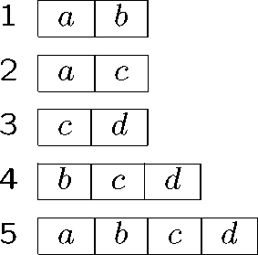
Representation of D
Row-wise
Column-wise
a b c d
1 |  | 1 |  | 2 |  | 3
2 |  | 4 |  | 3 |  | 4
5 |  | 5 |  | 4 |  | 5
 |  |  |  | 5
Boolean
 | a | b | c | d
1 | 1 | 1 | 0 | 0
2 | 1 | 0 | 1 | 0
3 | 0 | 0 | 1 | 1
4 | 0 | 1 | 1 | 1
5 | 1 | 1 | 1 | 1

Slide 21
Definitions cont’d
• Given F and a Minimum confidence threshold MinConf
• Generate rules:
(l - C) ^ C
,, . . supp(l)
conf((l — C) ^ C) = > MinConf
supp(l — C)
• From a k — itemset (k > 1), one can generate 2^{k} — 1 rules.
Property
Let l be a large (frequent) itemset:
VC C l, C = 0, [(l — C) ^ C] is strong ^ VC C C, C = 0, [(l — (?) ^ C] is strong

Slide 22
Example
Minconf=60%
Itemset | Rule# | Rule | Confidence | Strong?
 | 1 | a — b | 2/3 = 66.66% | yes
ab | 2 | b — a | 2/3 = 66.66% | yes
 | 3 | a —— c | 2/3 = 66.66% | yes
ac | 4 | c —— a | 2/4 = 50.00% | no
 | 5 | b — c | 2/3 = 66.66% | yes
bc | 6 | c — b | 2/4 = 50.00% | no
7 | 7 | b — d | 2/3 = 66.66% | yes
bd | 8 | d — b | 2/3 = 66.66% | yes
 | 9 | c —— d | 3/4 = 75.00% | yes
Cd | 10 | d —— c | 3/3 = 100.00% | yes

Slide 23
Example
Minconf=60%
Itemset | Rule# | Rule | Confidence | Strong?
 | 11 | cd ^ b | 2/3 = 66.66% | yes
bcd | 12 | bd ^ c | 2/2 = 100.00% | yes
 | 13 | bc ^ d | 2/2 = 100.00% | yes
Itemset | Rule# | Rule | Confidence | Strong?
 | 14 | d ^ bc | 2/3 = 66.66% | yes
bcd | 15 | c ^ bd | 2/4 = 50.00% | no
 | 16 | b ^ cd | 2/3 = 66.66% | yes

Slide 24
Probabilistic Interpretation
Brin et al. 97
R : A —► C
• R measures the distribution of A and C in the finite space D.
• The sets A and C are 2 events
• P(A) and P(C) the probabilities that events A and C happen resp. estimated by the the frequency of A and C resp. in D
supp(A ^ C) = supp(A U C) = P(A A C)
P(A A C)
conf (A ^ C) = P(C|A)
P(A)

Slide 25
Support-Confidence: cons
• Example (Brin et al. 97)
 | coffee | coffee | rows
tea | 20 | 5 | 25
tea | 70 | 5 | 75
X) columns | 90 | 10 | 100
tea ^ coffee (supp = 20%, conf = 80%)
Strong rule?

Slide 26
Support-Confidence: cons
• Example (Brin et al. 97)
 | coffee | coffee | rows
tea | 20 | 5 | 25
tea | 70 | 5 | 75
X) columns | 90 | 10 | 100
tea ^ coffee (supp = 20%, conf = 80%)
Strong rule? Yes but a misleading one!
Support (coffee) = 90% is a bias that the confidence cannot detect because it ignores support(coffee).

Slide 27
Other evaluation Measures
• Interest (Piatetsky-Shapiro 91) or Lift (Bayardo et al. 99)
P (A A C)
P(A) x P(C)
supp(A U C) supp(A) x supp(C)
Interest(A ^ C)
Interest is between 0 and
1. If Interest(R) = 1 then A and C are independent;
2. If Interest(R) > 1 then A and C are positively dependent;
3. If Interest(R) < 1 then A and C are negatively dependent.
conf (A ^ C) supp(C )
conf (C ^ A) supp(A)
Interest(A ^ C)

Slide 28
Other evaluation Measures
 | coffee | coffee | rows
tea | 20 | 5 | 25
tea | 70 | 5 | 75
columns | 90 | 10 | 100
, „ „ _{x} P(tea A coffee) 0.2
Interest(tea ^ coffee) = =
P(tea) x P(coffee) 0.25 * 0.9
0.89 < 1
 | coffee | coffee
tea | 0.89 | 2
tea | 1.03 | 0.66

Slide 29
Multi-dimensional rules
• One-dimensional rules:
buy(x, “Bread!') —> buy(x, “Butter")
• Multi-dimensional rules:
buy(x, “Pizza") A age(x, “Young") —> buy(x, “Coke")
• Construct k-predicatesets instead of k-itemsets
• How about numerical features?
buy(x, “Pizza") A age(x, “18 — 22'') —> buy(x, “Coke")

Slide 30
Post-processing of AR
• AR framework may lead to a large number of rules.
• How one can reduce the number of rules?
1. Use many evaluation measures
2. Increase minimum support
3. Increase minimum confidence
4. use rule templates (define constraints on max rule length, exclude some items, include in the rules specific items) (Agrawal et al. 1995, Salleb et al. 2007)

Slide 31
Implementations
• FIMI Frequent Itemset Mining Implementations Repository http://fimi.cs.helsinki.fi/ FIMI'03 and FIMI'04 workshop, Bayardo, Goethals & Zaki
• Apriori http://www.borgelt.net/apriori.html developed by Borgelt
• Weka http://www.cs.waikato.ac.nz/ml/weka/ by Witten & Frank
• ARMADA Data Mining Tool version 1.3.2 in matlab available at Mathworks, by Malone

Slide 32
FP algorithms
According to the strategy to traverse the search space:
• Breadth First Search (ex: Apriori, AprioriTid, Partition, DIC)
• Depth First Search (ex: Eclat, Clique, Depth project)
• Hybrid (ex: AprioriHybrid, Hybrid, Viper, Kdci)
• Pattern growth, i.e. no candidate generation (ex: Fpgrowth, HMine, Cofi)

Slide 33
Uniform notion of item
• Apriori has been initially designed for boolean tables (trans¬ actional datasets) thus propositional logic was sufficient to ex¬ press: items, itemsets and rules.
milk —> cereals
• For relational tables, one need to extend the notion of items to literals:
item = (attribute, value)
An attribute could be:
1. categorical, forex. (color,blue),
2. quantitatif with a few numerical values, for ex. (#cars, 2),
3. quantitatif with a large domain values, for ex. (age, [20,40]).

Slide 34
Example
D : people
id | age | married? | #cars
1 | 23 | no | 1
2 | 25 | yes | 1
3 | 29 | no | 0
4 | 34 | yes | 2
5 | 38 | yes | 2
Examples of frequent itemsets
itemset | support
(age, 20..29) | 3
(age, 30..39) | 2
(married?, yes) | 3
(married?, no) | 2
(#cars, 1) | 2
(#cars, 2) | 2
(age, 30..39),(married?, yes) | 2
Examples of rules
rule | support | confidence
(age, 30..39) et (married?, yes) —> (#cars, 2) (age, 20..29) —> (#cars, 1) | 40% 60% | 100% 66.6%

Slide 35
Quantitative AR_
Question: Mining Quantitative AR is not a simple extension of mining categorical AR. why?
• Infinite search space: In Boolean AR, the Ariori property allows to prune the search space efficiently, but we do explore the whole space of hypothesis (lattice of itemsets), which is IMPOSSIBLE for Quantitative AR.
• The support-confidence tradeoff: Choosing intervals is
quite sensitive to support and confidence.
- intervals too small, not enough support;
- intervals too large, not enough confidence.
• What is the difference between supervised and unsupervised discretization?

Slide 36
Approaches to mine QARs
• Discretization-based approaches
• Distribution-based approaches
• Optimization-based approaches

Slide 37
Approaches to mine QARs
Discretization-based approaches
• A pre-processing step
• Use equi-depth, equi-width, domain-knowledge
• Lent et al., 1997; Miller and Yang, 1997; Srikant and Agrawal, 1996; Wang et al., 1998
• Discretization combined with clustering or interval merging.
• Problems: univariate, sensitive to outliers, loss of information.

Slide 38
Approaches to mine QARs
Distribution-based approaches
Sex = female ^ Height : mean = 168 A Weight : mean = 68
• Aumann and Lindell, 1999, Webb 2001.
• Restricted form of rules:
1. A set of categorical attributes on the left-hand side and several distributions on the right-hand side,
2. A single discretized numeric attribute on the left-hand side and a single distribution on the right-hand side.

Slide 39
Approaches to mine QARs
Optimization-based approaches
• Numerical attributes are optimized during the mining process
• Fukuda et al., 96, Rastogi and Shim 99, Brin et al. 2003. Techniques inspired from image segmentation.
Gain(A ^ B) = Supp(AB) — MinConf * Supp(A)
Form of the rules restricted to 1 or 2 numerical attributes.
• Mata et al. 2002 Use genetic algorithms to optimize the sup¬ port of itemsets with non instantiated intervals.
Fitness = cov — * ampl) — (u * mark) + (p * nAtr)
Apriori-like algorithm to mine association rules.

Slide 40
Approaches to mine QARs
Optimization-based approaches
• Ruckert et al. 2004 use half-spaces to mine such rules like:
x\ > 20 —> 0.5^3 + 2.3x0 > 100 Cannot handle categorical attributes.
Salleb et al 2007: QuantMiner Optimize the Gain of rules templates using a genetic algorithm.
Ui
Domain of Attribute^
ii ui
li_^{u}i
ii ui
li_^{u}
^{l}i ^{u}i
i _{i} u ^{i}_{i}
i
ui
1 mutation.
H
ui

Slide 41
Approaches to mine QARs
Optimization-based approaches: QuantMiner cont'd. Example UCI Iris dataset:
Species= PW G [1i,ui] SW G [1₂,u₂] supp%
value ^ PL G [l₃,u₃] SL G [l₄,u₄] conf%
Species= PW G [1, 6] SW G [31,39] 23%
setosa ^ PL G [10, 19] SL G [46, 54] 70%
Species= PW G [10, 15] SW G [22,30] 21%
versicolor ^ PL G [35,47] SL G [55, 66] 64%
Species= PW G [18,25] SW G [27,33] 20%
virginica ^ PL G [48, 60] SL G [58, 72] 60%

Slide 42
QuantMiner
http://quantminer.github.io/QuantMiner/

Slide 43
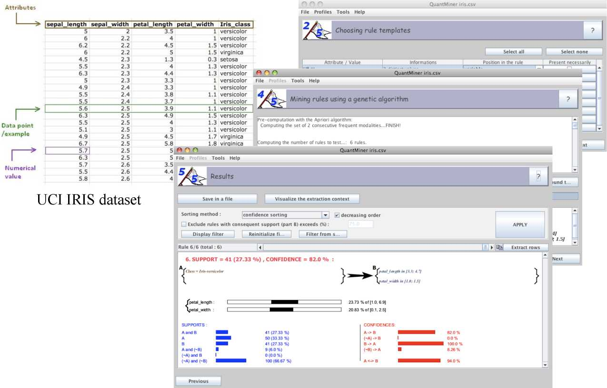
QuantMiner

Slide 44
References
• R. Agrawal, T. Imielinski and A.N. Swami “Mining Association Rules be¬ tween sets of items in large databases”. SIGMOD 1993.
• R. Agrawal, R. Srikant“Fast algorithms for mining association rules ” VLDB 1994.
• B. Goethals “Survey on Frequent Pattern Mining” Technical report, Helsinki Institute for Information Technology, 2003.
• S. Brin et al. “Beyond Market Baskets: Generalizing Association Rules to Correlations”. SIGMOD 1997.
• R. Agrawal et al. “Mining association rules with item constraints”. KDD 1997.
• A. Salleb et al. “QuantMiner: A Genetic Algorithm for Mining Quantitative Association Rules”, IJCAI 2007.
• U. M. Fayyad, G. Piatetsky-Shapiro, and P. Smyth. “From Data Mining to Knowledge Discovery: An Overview”. In Advances in Knowledge Discovery and Data Mining, 1996.

Slide 45





IKUTI KAMI
digitalent.kominfo
digitalent.kominfo
DTS_kominfo
Digital Talent Scholarship 2019
Pusat Pengembangan Profesi dan Sertifikasi
Badan Penelitian dan Pengembangan SDM
Kementerian Komunikasi dan Informatika
Jl. Medan Merdeka Barat No. 9
(Gd. Belakang Lt. 4 - 5)
Jakarta Pusat, 10110
digitalent.kominfo.go.id

